Slide 1





CEIP: Combining Explicit and Implicit Priors for Reinforcement Learning with Demonstrations
Kai Yan, Alexander G. Schwing, Yu-Xiong Wang
University of Illinois Urbana-Champaign
Notes:
Hi I’m Kai Yan, today I’ll tell you our paper “CEIP: Combining Explicit and Implicit Priors for Reinforcement Learning with Demonstrations”.

Slide 2
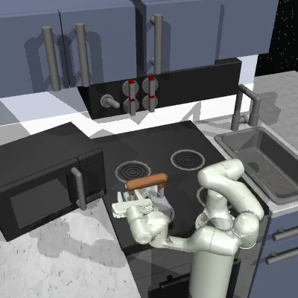
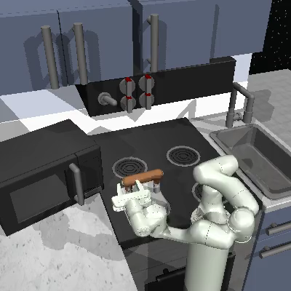
Why Demonstrations?
Plain Reinforcement Learning (RL) struggles with sparse reward
Demonstrations can help exploration
Random exploration
w/o demonstrations
Random exploration
w/ demonstrations
What demonstrations to use?
How we use demonstrations?
Why our use of demonstrations?
Notes:
In this work, we aim to improve the sample efficiency of reinforcement learning (RL) by utilizing demonstrations, because previous works have found that plain reinforcement learning from scratch struggles in a sparse reward setting.
Suppose you are training a robotic arm for manipulation tasks, as is shown in the video bottom left. With the common random exploration noise, it will only jitter around without interacting with anything it supposed to be manipulating.
However, if the agent can also learn from existing successful demonstrations, as is shown in the video bottom right, although still imperfect, it knows where to explore, which item to manipulate, and thus have a much larger probability to learn the task.
So, we need to use the demonstrations. Based on this, the following presentation answers three questions, which are “what demonstrations to use”, “how we use demonstrations”, and “why our use of demonstrations”.

Slide 3
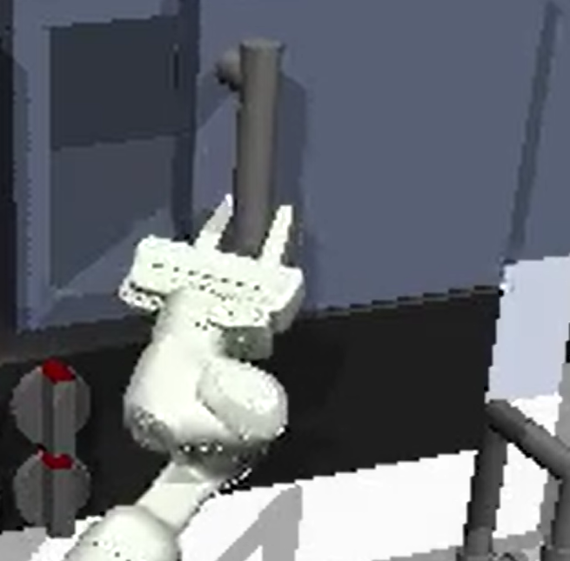
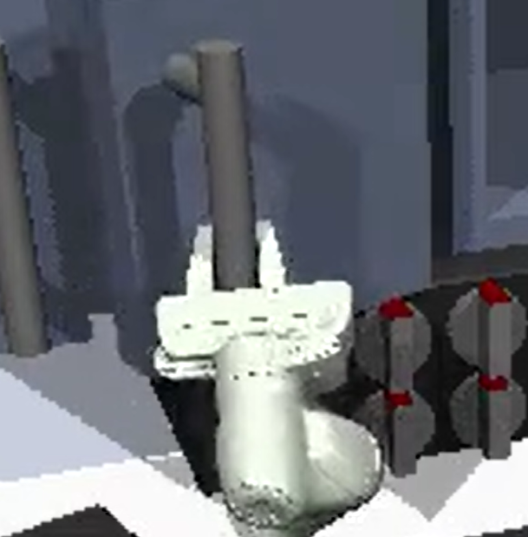
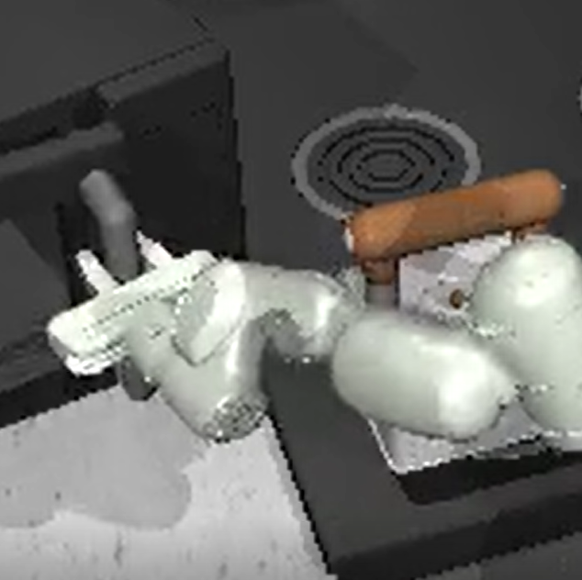
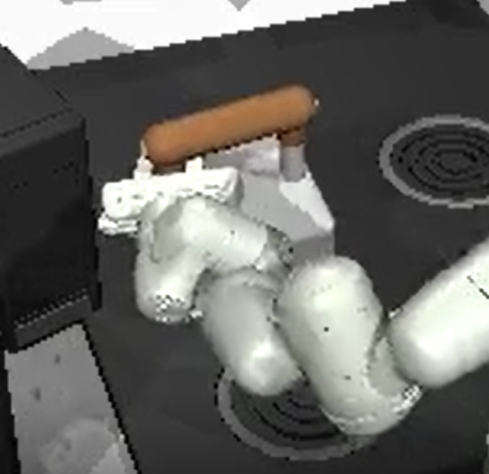
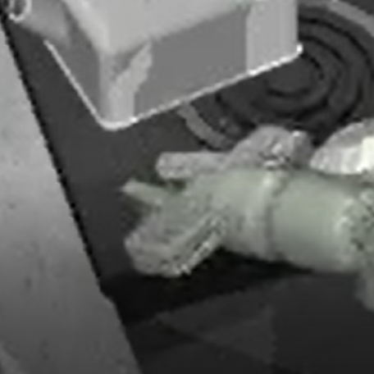
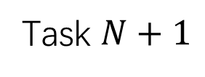
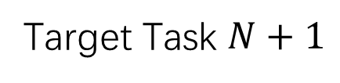
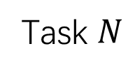
Q1. What Demonstration Do We Use?
Task-specific
Informative, expensive, few
Expensive to collect for every task
Task-agnostic
Less related, cheap, many
Accumulated from existing tasks or via autonomous exploration
Usable Data
Target Task $N+1$
Task $N+1$
Task 1
Task 2
Task $N$
Auto-Explore
…
…
Notes:
Firstly, what demonstrations should we use? The most apparent answer is demonstrations on the identical task to our target; as illustrated below, if you want to learn task N plus one, you will probably go for the yellow part, demonstrations on task N plus one by the experts, which we called “task-specific” data, because it’s the most informative. But such demonstrations can be expensive and few, because it needs to be collected whenever a new task arrives.
Thus, people also leverage the green part of the usable data which we called “task-agnostic” data. They are less related, but much more and cheaper because they can be accumulated when you previously solve task from one to N. It can also be quickly generated from autonomous exploration without human effort. In this work, we will use both task-specific and task-agnostic data.

Slide 4
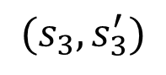
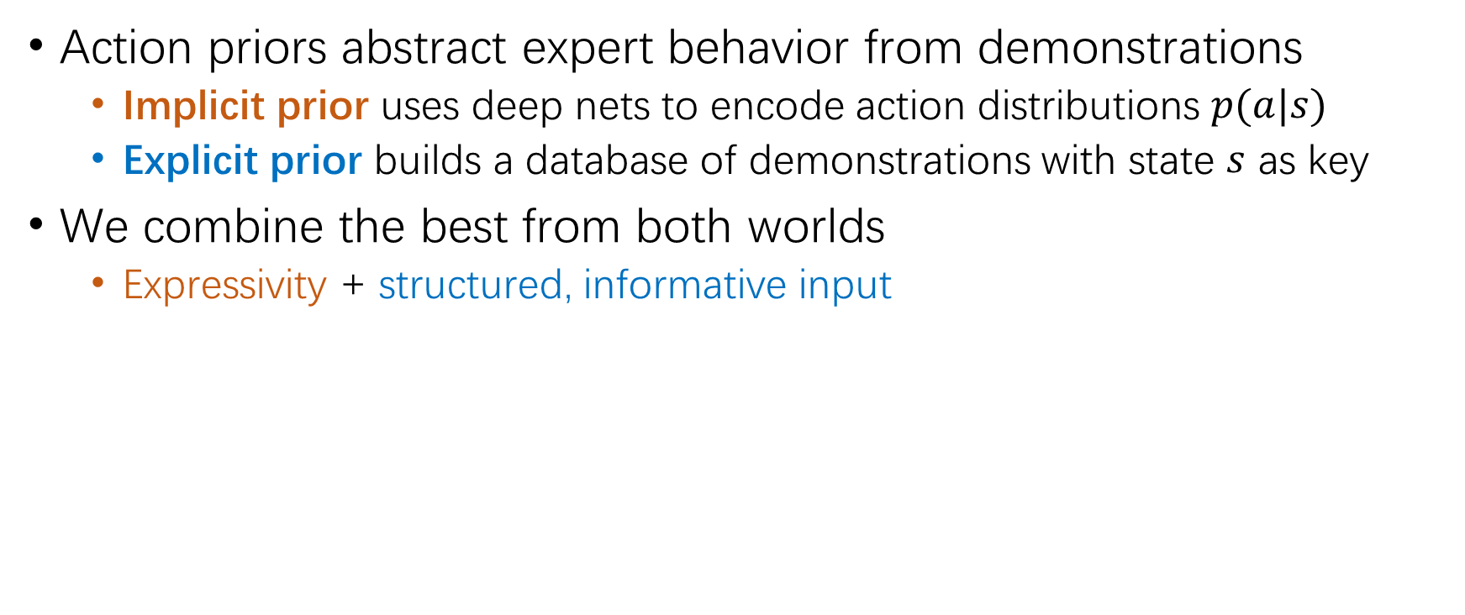
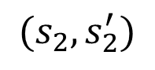
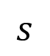
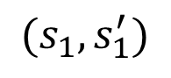
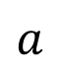
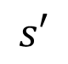
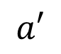
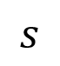
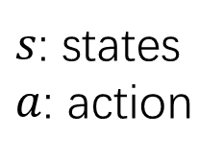
Q2. Use Demonstrations with Action Priors
Action priors abstract expert behavior from demonstrations
Implicit prior uses deep nets to encode action distributions $p(a|s)$
Explicit prior builds a database of demonstrations with state $s$ as key
We combine the best from both worlds
Expressivity + structured, informative input
$s$: states
$a$: action
$$s$$
$$s$$
Query
$$(s_{1},s_{1}^{′})$$
$$(s_{2},s_{2}^{′})$$
$$a′$$
$$a$$
$$(s_{3},s_{3}^{′})$$
Future State
$$s′$$
Implicit Prior: Normalizing flow
Explicit Prior: Database
Notes:
Then, secondly, how do we use demonstrations? The answer is action prior, which is an abstraction of expert behavior from demonstrations.
There are two types of action priors in the literature: one is the implicit prior, which uses deep nets to encode action distributions, and the other is explicit prior, which builds a database of demonstrations with state s as key.
In our work, we combine the best from both worlds, using both implicit and explicit prior to combine expressivity from deep net and structured, more informative input from database. The implicit prior illustrated in orange is a normalizing flow that takes current state s as input, and learns a bijection between action a, and a latent action a-prime that is much more similar to the RL agent’s initial action distribution, which is much easier to learn.
The explicit prior illustrated in blue is a database that takes current state s as query and retrieves predicted future state s-prime when following the expert trajectory, which informs the agent where to reach.

Slide 5
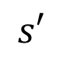
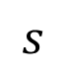
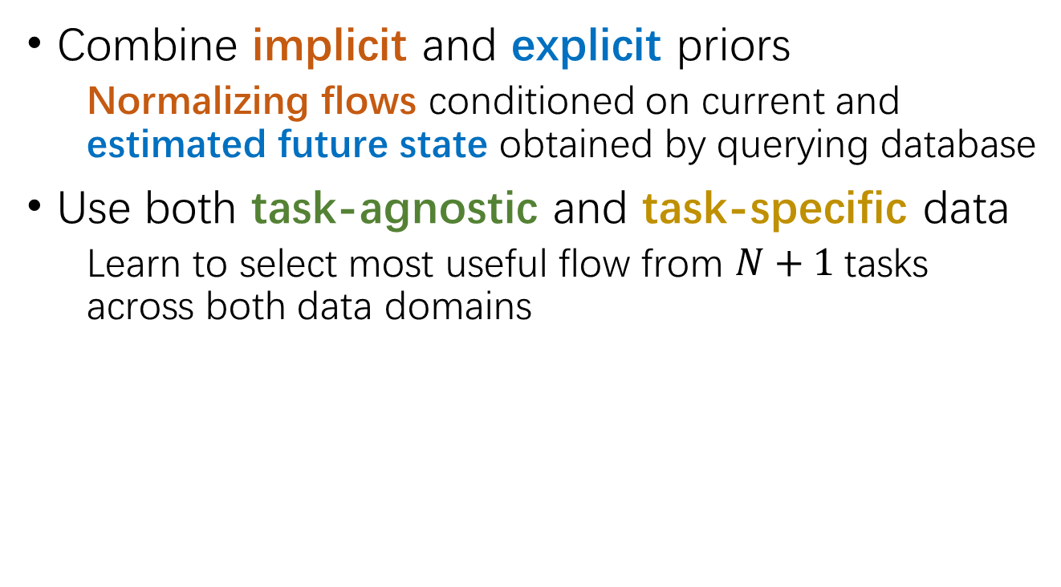
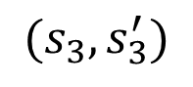
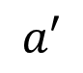

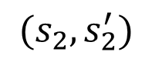
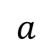
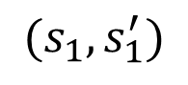
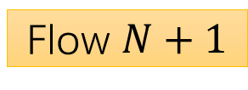
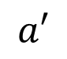
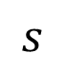
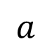
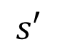
Q2. CEIP
$$s$$
$$(s_{1},s_{1}^{′})$$
$$(s_{2},s_{2}^{′})$$
Agent
$$(s_{3},s_{3}^{′})$$
$$a′$$
Combine implicit and explicit priors
Normalizing flows conditioned on current and estimated future state obtained by querying database
Use both task-agnostic and task-specific data
Learn to select most useful flow from $N+1$tasks across both data domains
Flows
$$s′$$
$$a$$
Env
$$s$$
MLP
Coefficients
$$×$$
$$a$$
$$s′$$
Flow 1
Flow 2
…
Flow $N+1$
$$a′$$
Notes:
We now introduce our proposed method CEIP, which integrates the implicit priors illustrated in orange and explicit prior illustrated in blue. As we have just introduced, the blue part queries the database of the task-specific dataset and retrieves predicted future state, which leads to a better mapping by the orange implicit prior, from the immature action a-prime by the gray RL agent to the action a learned from demonstrations.
And to select the most useful priors in the task-agnostic and task-specific data, we decompose the normalizing flow of the implicit prior into a learned linear combination, where we train a single flow for each task from both data, and then coefficients predicted by the MLP to select the most useful flow from each task. The final output of the flow mixture, which is also a flow, is the linear combination over each flow’s output with weight being the coefficients from the MLP. Finally, we plug the whole thing into the RL environment illustrated gray in the slides, and completes the cycle.

Slide 6
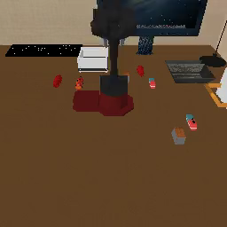

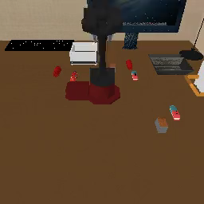
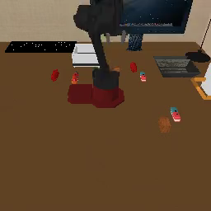

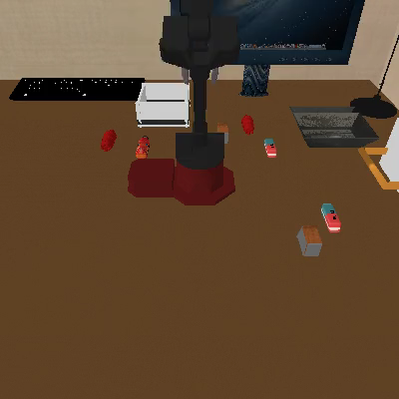
Q3. Why Use CEIP Over Existing Methods?
CEIP outperforms baselines; implicit and explicit priors both matter
Reward 1/8
Reward 1/8
Reward 2/8
Reward 3/8
Reward 1/8
Reward 6/8
Reward 3/8
Reward 1/8
Reward 2/8
Reward 0/8
Reward 1/8
Reward 1/8
Reward 2/8
Reward 2/8
Reward 0/8
Reward 2/8
Reward 3/8
Reward 4/8
Reward 5/8
Reward 2/8
Reward 0/8
Reward 0/8
Reward 4/8
Reward 0/8
Reward 7/8
Reward 0/8
CEIP
(Ours)
CEIP
(Single flow)
CEIP
(No exp.)
FIST [1]
PARROT [2]
SKiLD [3]
[1] K. Hakhamaneshi et al. Hierarchical few-shot imitation with skill transition models. In ICLR, 2022.
[2] A. Singh et al. Parrot: Data-driven behavioral priors for reinforcement learning. In ICLR, 2021.
[3] K. Pertsch et al. Demonstration-guided reinforcement learning with learned skills. In CoRL, 2021.
Notes:
So, the last question: Why our use of demonstrations over existing methods? Here on the left is the visualization of our method, in the middle are ablations where we use the baseline’s implicit prior or where explicit prior are missing. The baselines are on the right.
It is clearly shown that our use of demonstration works the best, almost completing all tasks, while the other methods struggle in the midway. Also, our method cannot work well without either implicit or explicit prior, which validates the effectiveness of combining both priors.

Slide 7


Thank you!
Feel free to contact kaiyan3@illinois.edu for any question!
Code Repository
PDF of Our Paper
Notes:
That’s all for our work. Thanks for listening!

